Slide 1

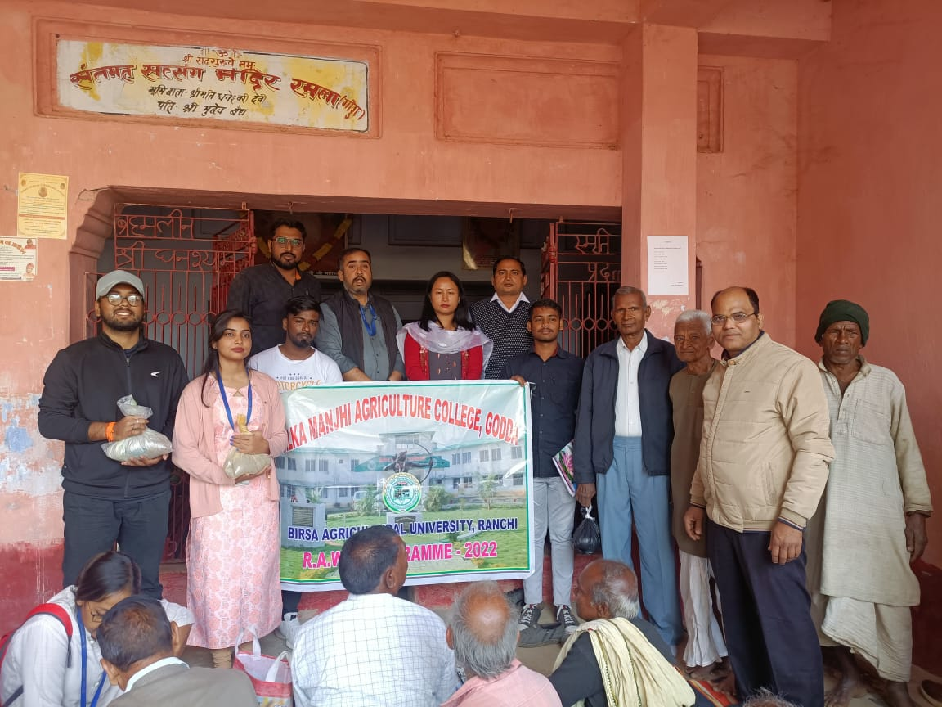
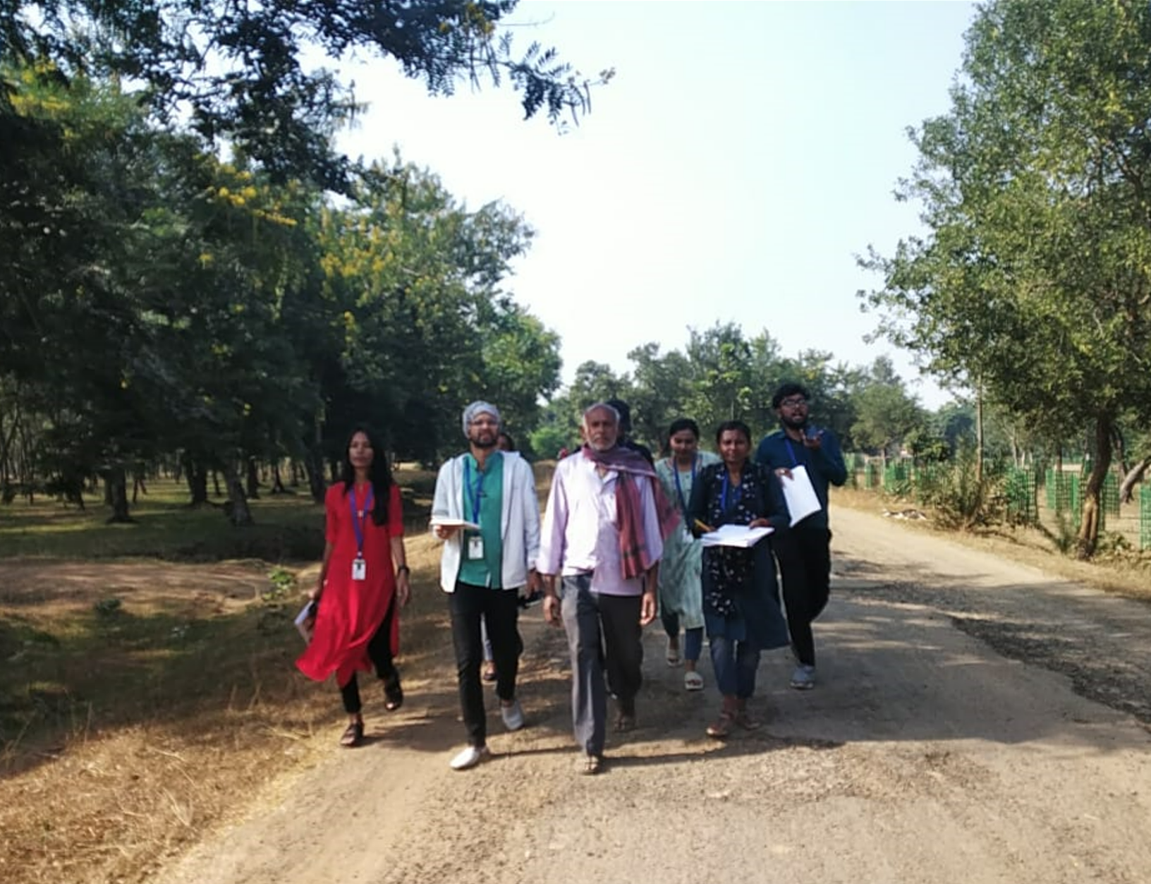
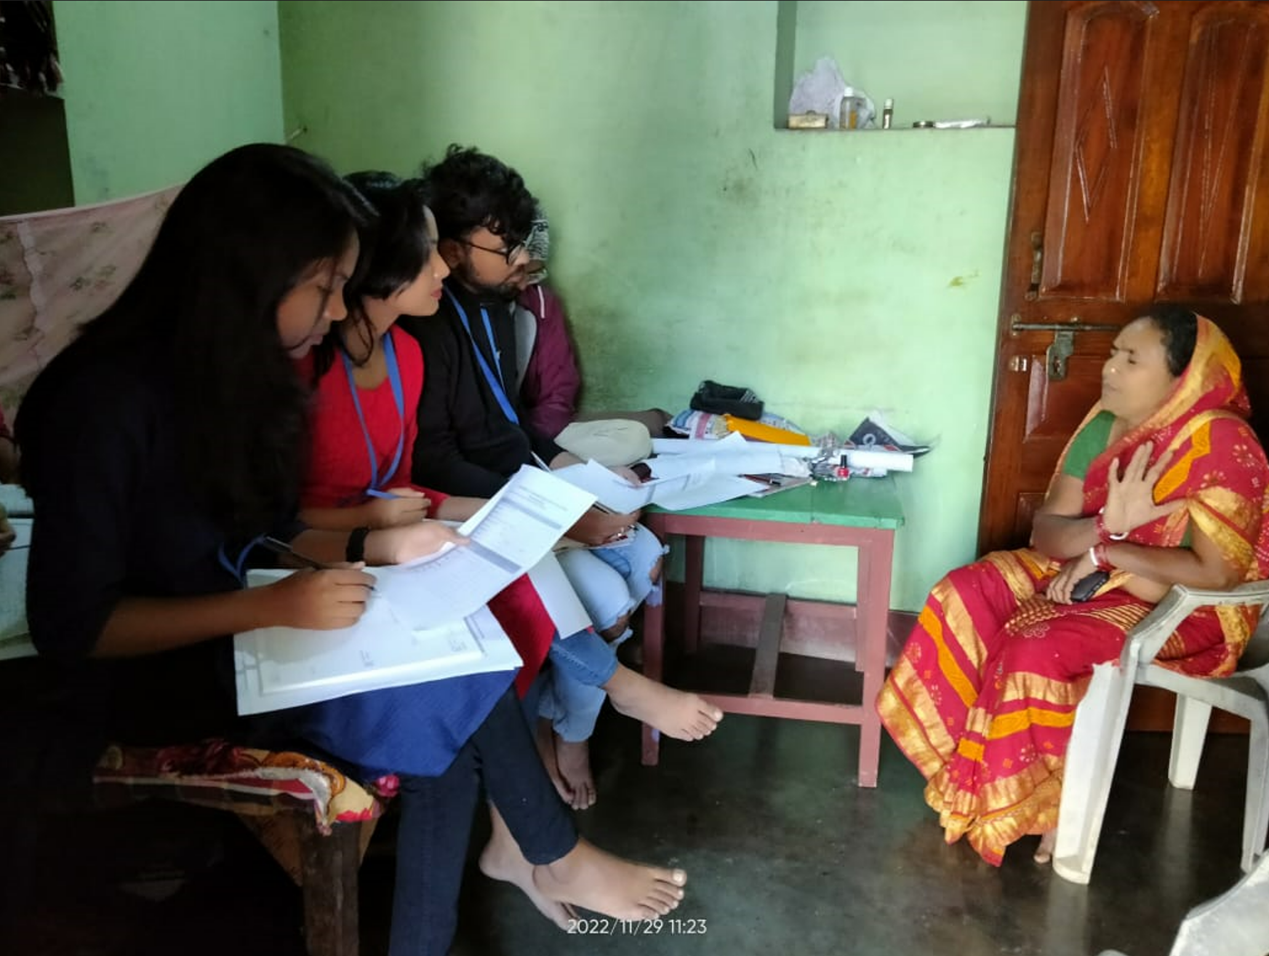
Anamika Pandey
A Report on Rural Agricultural Work Experience
(2022-23)
Guided by –
Dr. Abhijeet Satpathy
(Department of Extension education)
Prepared by –
NAME-ANAMIKA PANDEY
ROLL NO. -67
Reg. no - AGTG021967

Slide 2
Rural Agricultural Work Experience (2022-23)
Introduction
This programme covers 2 major sections – Village Attachment and Agro-Industrial Attachment or AIA.
RAWE involves students working with the farmers at their farms and homes, which helps students get acquainted with the practical problems related to on-field work.
In this programme, all students are allotted different villages and are assigned to carry out data collection and various other activities under the guidance of Professors.
AIA requires students to visit various established industries for an extended period of time, thus helping us acquire a perspective of how a corporation work.

Slide 3
Rural Agricultural Work Experience (2022-23)
What is RAWE?
History
In India, Randhawa Committee, in 1992, recommended RAWE programme for imparting pragmatism to the agricultural curriculum.
The programme was first put to test in 1995-96
Objective
Limitations
Inspire learning by doing
Understanding the socio-economic status of rural people
Application of our 3 years of theoretical curriculum
Learning to accept the indigenous knowledge of the farmers
Boost confidence and develop competency in the students to solve the problems related to agriculture at ground level
Inadequate time – the provided time limit for RAWE was not enough for exploring all the problems of the farmers
Small size of target respondents
Homogeneity of target people
Very little fund allotted for the course
Information of crops only from single season was available

Slide 4
Rural Agricultural Work Experience (2022-23)
Rapport Building
Village name – Ramla Naukhil
Block – Sadar Godda
District – Godda
State – Jharkhand
We reached Ramla village on 18th of Nov 2022 for the 1st time
We were welcomed warmly by Manohar Prashad Vaidh, the Mukhiya of the village and the other villagers
We all gathered in the "Satsang Bhawan" where the people of the village has arranged mattresses and Audio Amplifier Systems for our convenience
Gradually the villagers started sharing their problems, we heard it all and discussed the possible ways to solve them
They served us tea, biscuit, water and all of this was very overwhelming
Then we were allotted with our respective host farmers, and we left Satang Bhawan with them

Slide 5
Rural Agricultural Work Experience (2022-23)
Village Profile Study
Category | Numbers | Percentage
Male | 538 | 30%
Female | 535 | 30%
Children | 727 | 40%
Total Population | 1800 | 100%
Occupation | Numbers | Percentage
Professional | 05 | 0.68 %
Teacher and Managers | 12 | 1.64 %
Farmer | 514 | 70.6 %
Skilled laborer | 118 | 16.2 %
Unskilled laborer | 79 | 10.8 %

Slide 6
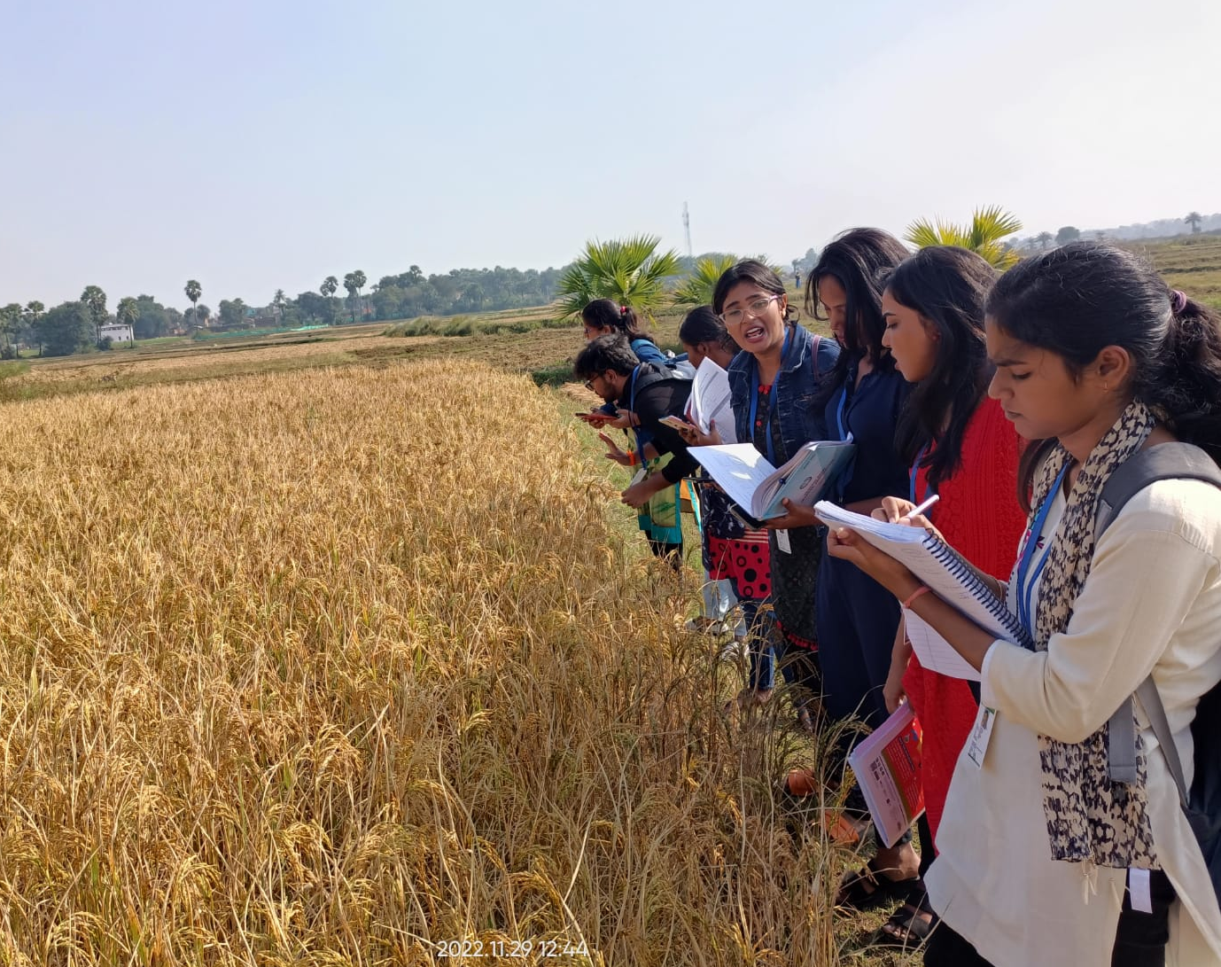
Agronomical
INTERVENTION

Slide 7
Rural Agricultural Work Experience (2022-23)
Learning objectives
To study the existing cropping system, constraints and possible recommendations.
To analyze the production practices of existing major field crops and technological gaps.
To assess the weed infestation and their management.
Recommendations of Line sowing over broadcasting
Broadcasting is the traditional method of sowing seeds by randomly scattering them on the line while walking. It was asked to replace it by line sowing which means sowing of the seeds in a fixed geometric pattern along vertical and horizontal.
While broadcasting may lead to over-crowding of crops thus diminishing growth, line sowing circumvents that by providing sufficient space for plant growth
Weed management can also be done more efficiently in line sowing

Slide 8
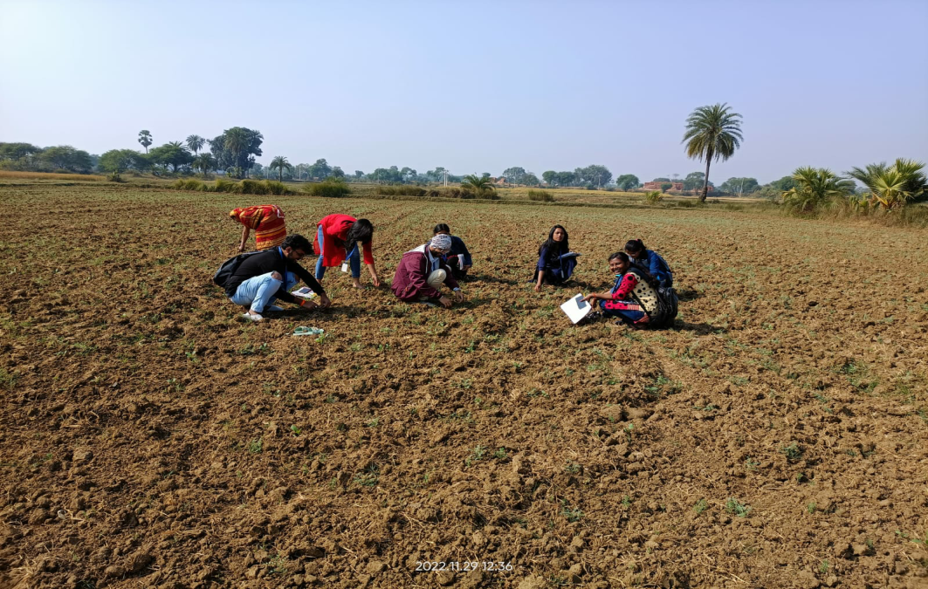
Rural Agricultural Work Experience (2022-23)
Weed management
Introduction
Weeds are the unwanted and undesirable plants that grows up with the wanted plants and compete with them for land, water and other resources and adversely affect their production.
Importance
Weeds compete with crops for water, soil, nutrients, light, and space, and thus reduce the crop yields
Act as alternate hosts of some of the pests and diseases
Some weeds release poisonous substances into the soil that may be harmful to the crop plants, human beings and livestock
Reduce yield and also interfere with agricultural operations
Hand weeding done by us in farmer’s field

Slide 9
Rural Agricultural Work Experience (2022-23)
A Critical period of Weed competition
Definition
Shortest time of crop growth when weeding result in higher economic returns.
The crop yield level obtained by weeding during this period is similar to that obtained by full season weed free conditions.
Nature of crop
Varieties
Factors influencing critical period of weed competition
Growing condition
Plant species
Period of weed growth
Weed crop density

Slide 10
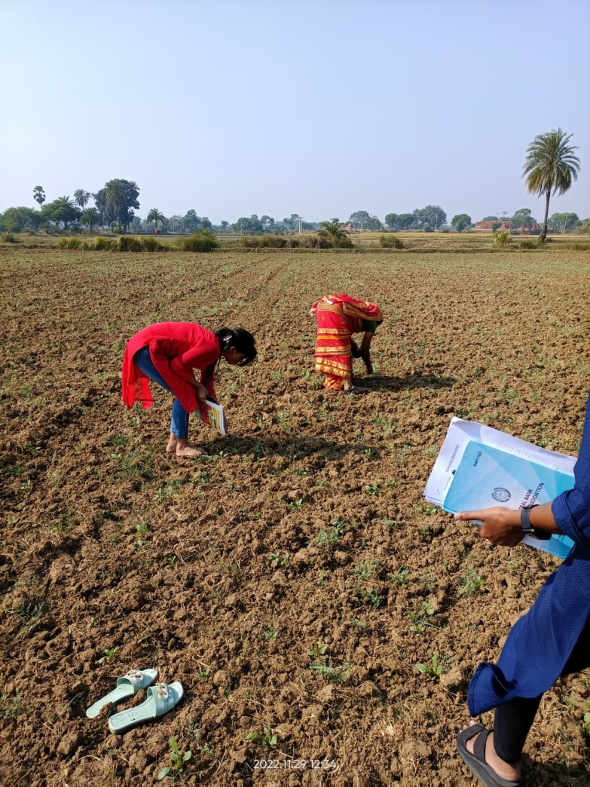
Rural Agricultural Work Experience (2022-23)
Weed management in Ramla Village
In Ramla village, the growth of weeds is one of the most neglected issues.
Farmers lack the awareness and means to tackle this problem
We told them that weeds deplete crops' nutrition and light and reduce yield
Weeds also interfere and cause inconvenience in agriculture operations
Recommended practices for weed control
Chemical weed control
Weeding performed by us in farmer’s field
Cultural method
Field preparation
Planting methods
Fertilizer application
Biological weed control
Bio-agents like insects, pathogens and other animals are used
Physical method
Hand weeding
Hand hoeing
Mulching

Slide 11
Rural Agricultural Work Experience (2022-23)
Chemical method of weed management
Chemical Weed control
(Most effective and efficient method)
Post-emergence herbicide application
Done after 30-40 days after sowing
Fallow application
Herbicide application more than 10 days before sowing
Ex – Controls Cynodon dactylon
Pre-plant application
2-10 days before sowing
Pre-emergence herbicides application
Done 1 to 4 days after sowing
Suggestions given by us-
Use proper dose of herbicide. Consult with experts regarding selection and recommendation of herbicides.

Slide 12
Rural Agricultural Work Experience (2022-23)
Plot wise information of the host farmer
Two major field crops cultivated in the village :
Wheat
Paddy
Name of the Host Farmer: Shintu Kumar
Name the field crops cultivated by host farmer: wheat, mustard.
Total area under field crops with host farmer (ha.) 0.107 ha (Irrigated/Rainfed)
Area under crop 1: 0.0642(wheat) ha, Area irrigated - 0.0642 Ha
Area under crop 2: 0.043(Mustard) ha, Area irrigated - 0.043 ha.
Source of Irrigation – Well
Previous Cropping History:
Kharif: fallow
Rabi: wheat, mustard
Zaid: fallow
Cropping Intensity (%): 100 % & Rotational Intensity (%): 100 %

Slide 13
Rural Agricultural Work Experience (2022-23)
Fertilizer dose recommendation
For wheat field
Calculation
The recommended those of fertilizer is 100:40:40 for 1 hectare(For irrigated conditions)
DAP contains 18% N and 46% P2O5
Urea contains 46% N
MOP contains 60% of k2O
Total land area of the farmer = 0.109 ha
wheat – 0.0642 ha, Fertilizer dose = 6.4:2.6:2.6
Farmer’s practice
Recommendation for my host farmer
Urea : weight used in kgs is three times the land area in kattha
DAP : weight used in kgs is twice the land in kattha
MOP : not used
Urea= 10 Kg
DAP = 5.6kg
MOP= 4.33kg
Suggestions
Farmers are advised to follow the recommended dose of FYM and Fertilizers
Half dose of N and full dose of P and K applied as basal and remaining half dose of Nitrogen applied as top dressing at 1st irrigation

Slide 14
Rural Agricultural Work Experience (2022-23)
Cost of cultivation of Wheat @ Area 0.0642 (ha)
Sl.no | Items | Unit | Inputs per unit area | Input in 0.0642 (ha) | Total cost(Rs.) per (ha)
1 | Hired male labourers | Man days - 0 | 0 | 0 | 0
2 | Hired female labourers | Man days – 0 | 0 | 0 | 0
3 | Bullocks | Hrs – 0 | 0 | 0 | 0
4 | Machinery charges
4.1 | Machine 1(Tractor) | Hrs – 36 mins | Rs. 1/metre-square | Rs. 600 | Rs. 9346
4.2 | Machine 2 | Hrs – NA | - | - | -
5 | Seed | Kg – 7 kgs | Rs. 0.0105x22=0.23 | Rs. 7x22=154 | *Rs. 109x22=2399
6 | Manure | Tonnes – 0.1 tonnes | - | - | -
7 | Fertilizers
7.1 | Fertilizer 1 (Urea) | Kg – 12.6 kgs | 0.17 Rs/metre-square | Rs. 655x.17=111 | Rs1728
7.2 | Fertilizer 2 (DAP) | Kg – 8.4 kgs | 0.44 Rs/metre-square | Rs. 655x.44=288 | Rs.4436

Slide 15
Rural Agricultural Work Experience (2022-23)
Cost of cultivation of Wheat @ Area 0.0642 (ha)
8 | Irrigations | Hrs – 12 hours | 2.2 Rs/metre-square | Rs. 1440 | Rs. 22430
9 | Crop protection | - | - | - | -
9.1 | Insecticides | 2 ml/l | 0.12Rs/metre-square | Rs 79 | Rs. 1230
9.2 | Fungicides | ml/g | - | - | -
9.3 | Herbicides | ml/g | - | - | -
10 | Land revenue/cess & taxes | 5 Rs/kattha/yr | - | Rs. 10.5 | Rs. 163.6
11 | Depreciations on implements & farm buildings | Rs. 2410 | - | - | Rs. 2410
12 | Expenses on acquisition on inputs and miscellaneous | Rs | 7.7 Rs/metre-square | Rs. 5003+79+10.5= Rs. 5082.5 | Rs.42749+1230+163= Rs 44,142
13 | Interest on working capital | Per cent | - | - | -
14 | Rental value of land | Rs | - | - | -
15 | Family male labourers | 5 Man days | 5.95 Rs/m^2 | Rs. 3900 | *Rs. 60,747
16 | Family female labourers | 3 Man days | 1.5 Rs/m^2 | Rs. 1000 | *Rs. 15,576
17 | Total | Rs | 15.24 Rs/m^2 | Rs. 9,982.5 | Rs. 1,20,465
18 | Supervision charges 10% of total cost | Rs | 1.52Rs/metre-square | Rs. 998.25 | Rs. 12,046.5

Slide 16
Rural Agricultural Work Experience (2022-23)
Cost of cultivation of Wheat @ Area 0.0642 (ha)
Total cost of cultivation: (Row no. 17 + Row no. 18) = Rs. 1,32,512
Yield Grain 23.36 q/ha and Straw = 32.7 q/ha
Price Grain @ Rs 20000 per quintal and Straw @ Rs. 900 per quintal
Gross return = Rs 496630
Net Profit Rs = (Row no. 22 - Row No. 19) = Rs. 3,65,118
1 acre = 26 Kattha
1 Kattha = 157 metre-square
1 hectare = 65 Kattha

Slide 17
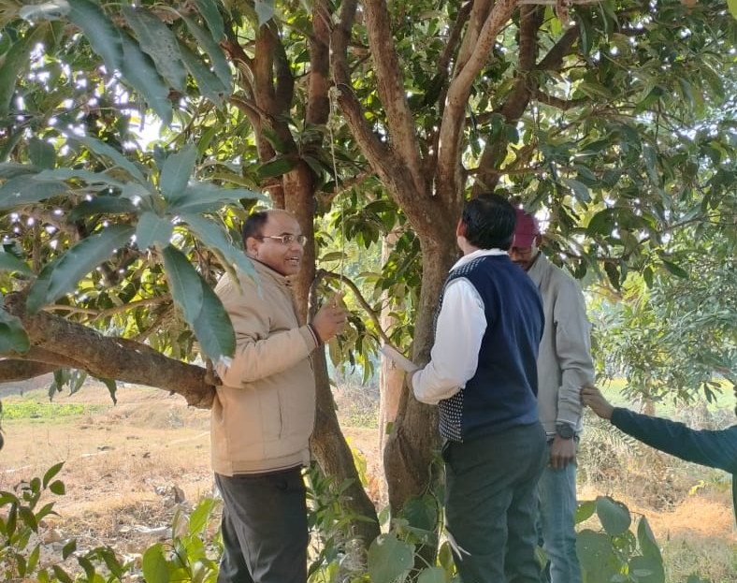
Horticultural
INTERVENTION

Slide 18
Rural Agricultural Work Experience (2022-23)
Canopy management
Heading back
Thinning out
Canopy management
Manipulation of tree canopies to optimize the production of quality fruits
Pruning
Improve its shape, influence its growth, flowering and fruitfulness and improve the quality of product
Diverts energy from one part of the plant to another
Training
Developing a desired shape of the tree by controlling growth habit
Central leader system
Bulk pruning
Modified leader system
Dehorning
Open center system

Slide 19
Rural Agricultural Work Experience (2022-23)
Canopy management in bearing mango orchard
Alternate bearing of mango
Identify an uprightly growing branches
Remove only 1-2 uprightly growing branches (Oct - Dec)
In bearing mangoes not more than 25% should be removed
In HDP system remove 10 to 15% of biomass annually during October to December
Mango producing good crop one year and no crop or fewer crops in the next year is known as biennial bearing or alternate bearing
Causes
Climatological factors
Age and size of shoots
Carbon – Nitrogen ratio
Hormonal balance
Management
Pruning
Growing regular bearing cultivars(Bangalore)
Deblossoming
Maintenance of orchards

Slide 20
Rural Agricultural Work Experience (2022-23)
Horticultural Intervention
Name of Host farmer : Manohar Vaidh
Name of Village & district: Ramla Naukhil, Godda
Major horticultural crops of the village: Fruit- Mango; Vegetables- Potato
Land type : Upper land
Total area : 0.73 ha
Total area under Hort. Crops (in ha.) : 0.23 ha (Mango Orchard), 0.08 ha (Potato)
Crops information: Mango variety- Malda, Potato variety- Kufri Jyoti
Irrigation:
Sources- Deep well
Irrigated area (in ha.) – 0.73 ha
Non-irrigated area (in ha.) – Nil
Field preparation
Layout and time of planting (month): Mango : July- August; Potato : October
Weeds known to farmer (Local name) : Motha

Slide 21
Rural Agricultural Work Experience (2022-23)
Problems identified on field preparation
SI. No. | Problem identified | Farmers practices in field | Recommended Suggestion to farmer
 | Presence of weeds in field | Remove weeds where required | Use of pre-emergence weedicides to overcome the problem of weeds.
 | Mango cultivar- Malda | Use same old variety of mango, alternate bearing variety | Use of regular bearing mango variety such as Neelam.
 | Spacing in mango plantation | Traditional practice- use of 10 x10 spacing | Modern spacing of 5 x 5 cm in mango plantation
4. | Monocropping | Use of single variety of crop and single crop in a year | Use of crop rotation and change of cultivar

Slide 22
Rural Agricultural Work Experience (2022-23)
Vegetables
Crop: Potato || Area cultivated: 0.08 ha || Status of production technology: Self-consumption || Irrigated area: 0.08 ha
Crop Profile
Sl. | Name of Vegetables | Varieties | Area under cultivation | Fertilizer dose | Yield
 | Potato | Kufri Jyoti | 0.08 ha | DAP- 2.5 kg Urea- 5 kg | 600-800 kg
Problems
Sl. | Crops | Problem identification | Solution available | Solution Recommended | Activities Proposed/Ext teaching method
1. | Potato | Common scab | Early harvesting | Use of disease-free seed tuber and crop rotation | On- farm problem identification and solution recommended
2. | Potato | Use of monocropping | --------- | Crop rotation | Awareness

Slide 23
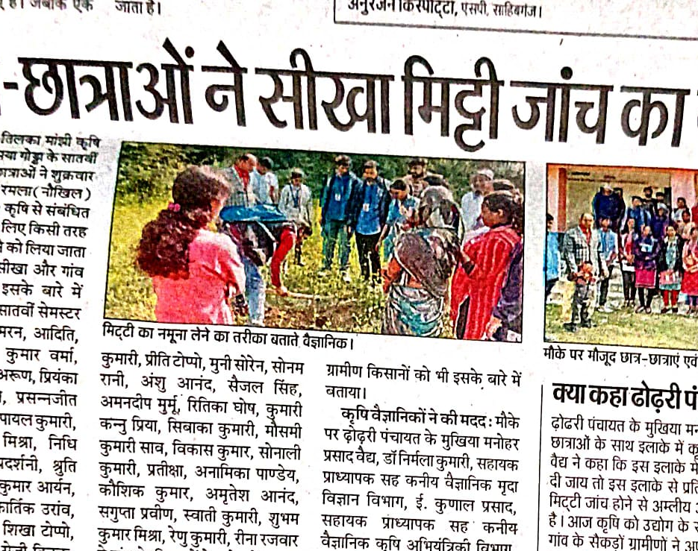
SOIL
INTERVENTION

Slide 24
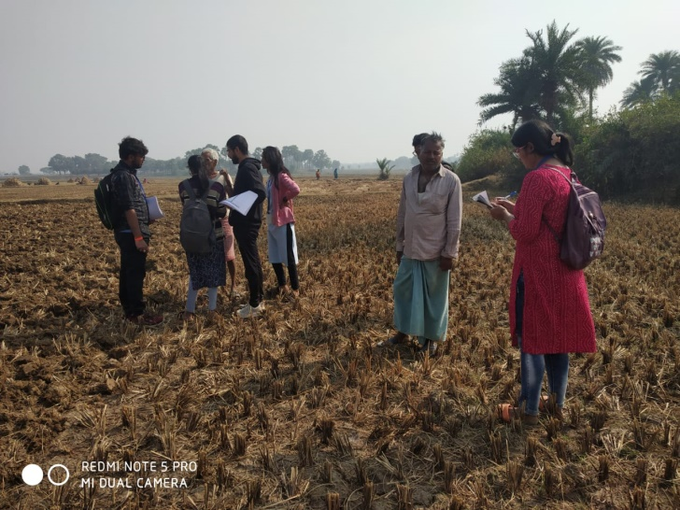
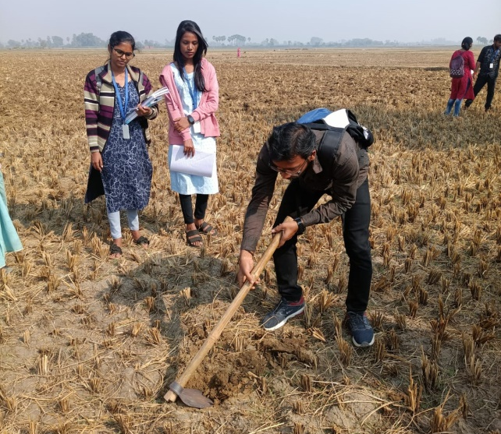
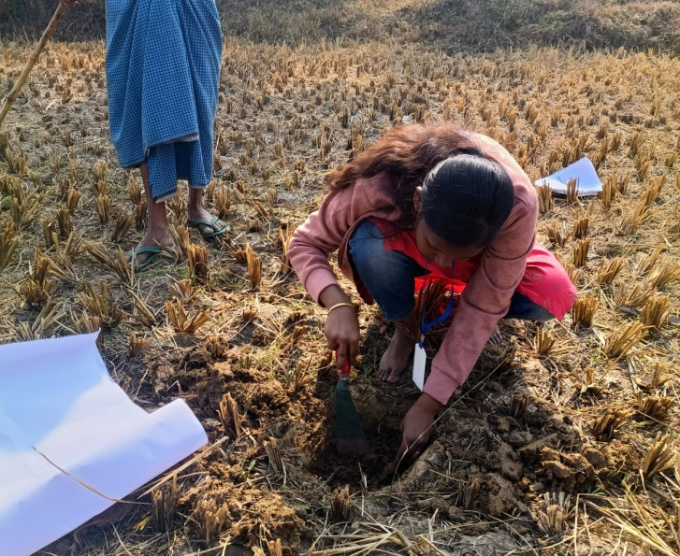
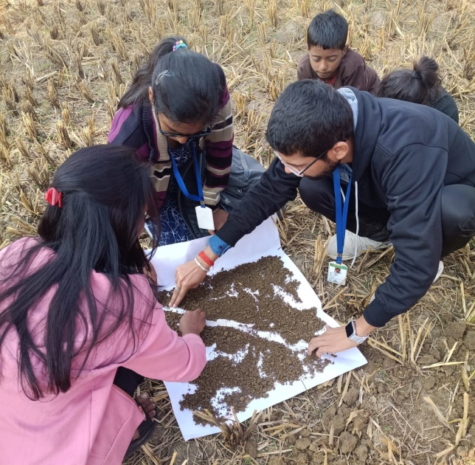
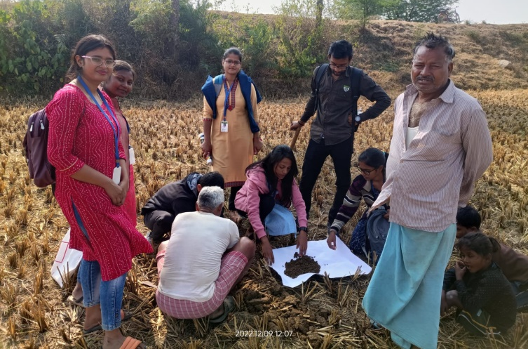
Rural Agricultural Work Experience (2022-23)
Soil sampling - Procedure
Soil testing
Divide the field into small units based on visual experience
Remove the surface litter by driving the hoe to plough depth of 15 cm to make a ‘V’ shaped cut
Remove thick slices (approx. 1 inch ) of soil from top to bottom of the exposed face of the ‘V’ shaped cut
Then divide the soil into 4 paths and remove the soil on the opposite side, mix the remaining soil then repeat the process again until we get desirable amount
Spread it on the chart paper and remove pebble stone, weed and other things

Slide 25
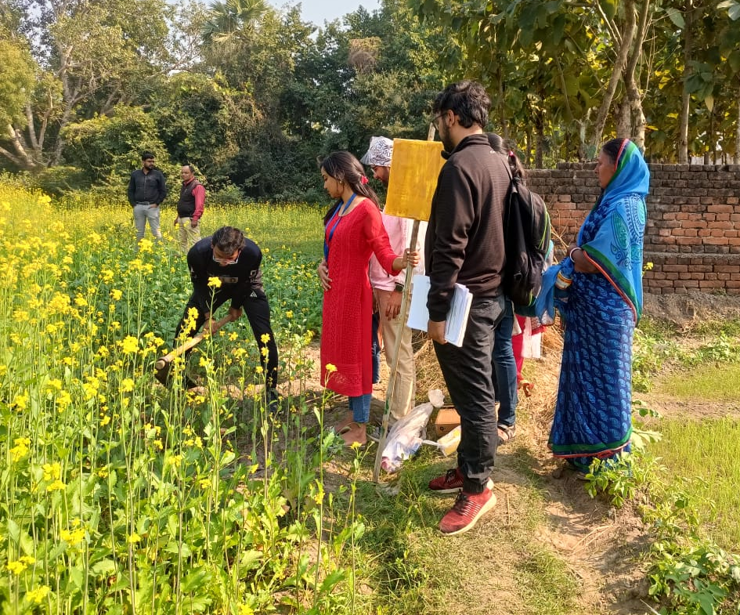
Plant
Protection
INTERVENTION

Slide 26
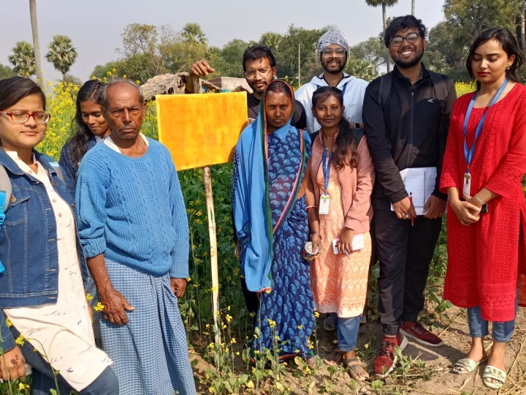
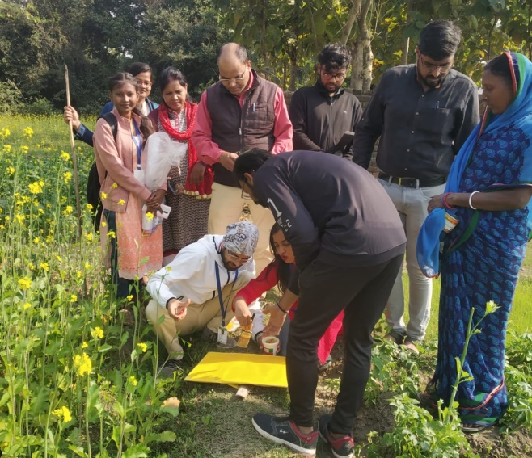
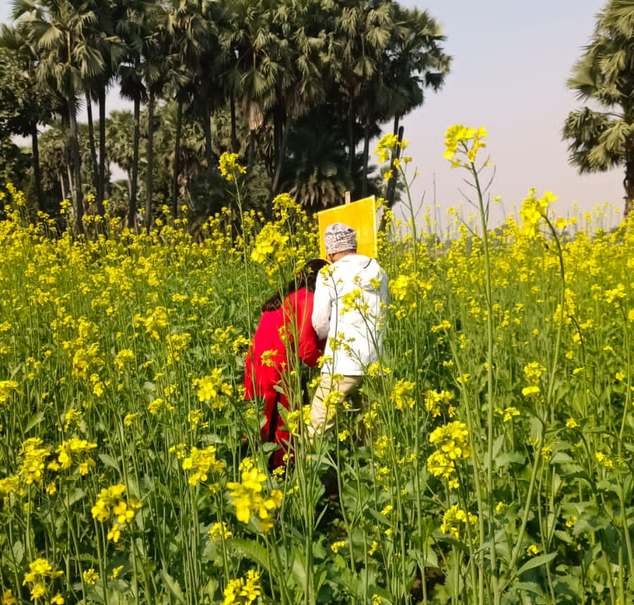
Rural Agricultural Work Experience (2022-23)
Entomology
Demonstration of yellow stick trap
Essential in the detection and partial elimination of many species of flying pests
Take a sheet of plywood board or hardboard or cardboard and paint it with Yellow colour oil paint
Allow it for drying. Apply grease or glue on the painted board
Erect these traps above crop canopy with the help of bamboo poles

Slide 27
Rural Agricultural Work Experience (2022-23)
Yellow sticky traps
Cleaning of traps
Clean the tin or plywood or hardwood traps by dipping into the hot water for couple of minutes to soften the sticky coating
Discard dead insects by using brush or duster
Dry the traps completely and recoat with similar glue for reinstallation
Cardboard traps should be discarded after use
Benefits: Highly effective, non-toxic and easy to use
Besides yellow sticky traps, light traps and pheromone traps are also used which are very effective against pests and insects

Slide 28
Rural Agricultural Work Experience (2022-23)
Crop-wise information
Control measures adopted
SI. | Insects’ name | Damage symptoms | Traditional practices (ITK) | Modern practices | Recommended practices
1 | Mustard Aphid | Nymphs & adults feed on flower buds, shoots, pods. Flowers don’t form pods. | Use of Kerosene oil. | Cultural control – early sowing; apply recommended dose of fertilizer. Mechanical control - Pheromone traps and yellow sticky traps Chemical control – spray 1L Dimethoate per ha. | Use of Neem oil Early sowing escapes the attack Set up yellow sticky trap. Use of natural enemies like ladybird beetles (Coccinella septempunctata).
Commonly available insecticides in the village:
Trade name - Rogor
Chemical name - Dimethoate
Precautions observed while using insecticides :
Avoid direct contact with hands.
Always apply insecticide in recommended dose

Slide 29
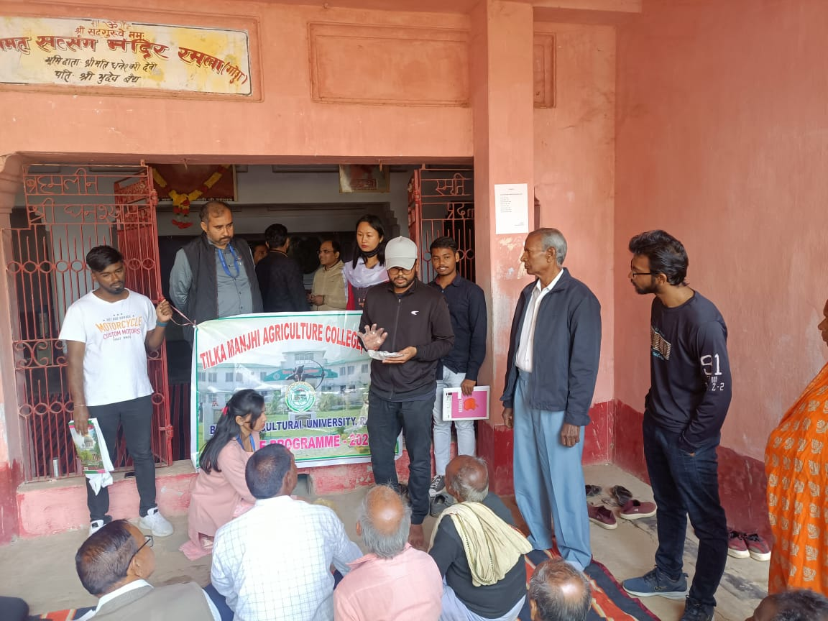
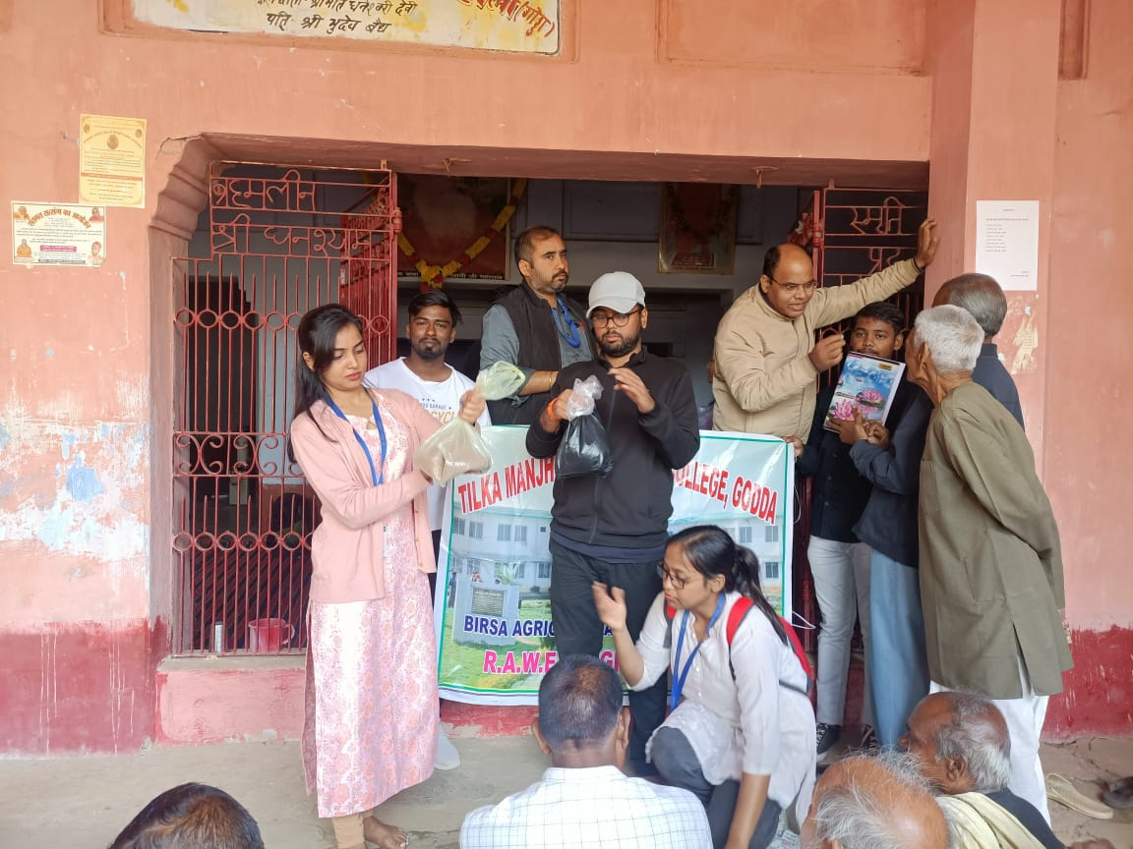

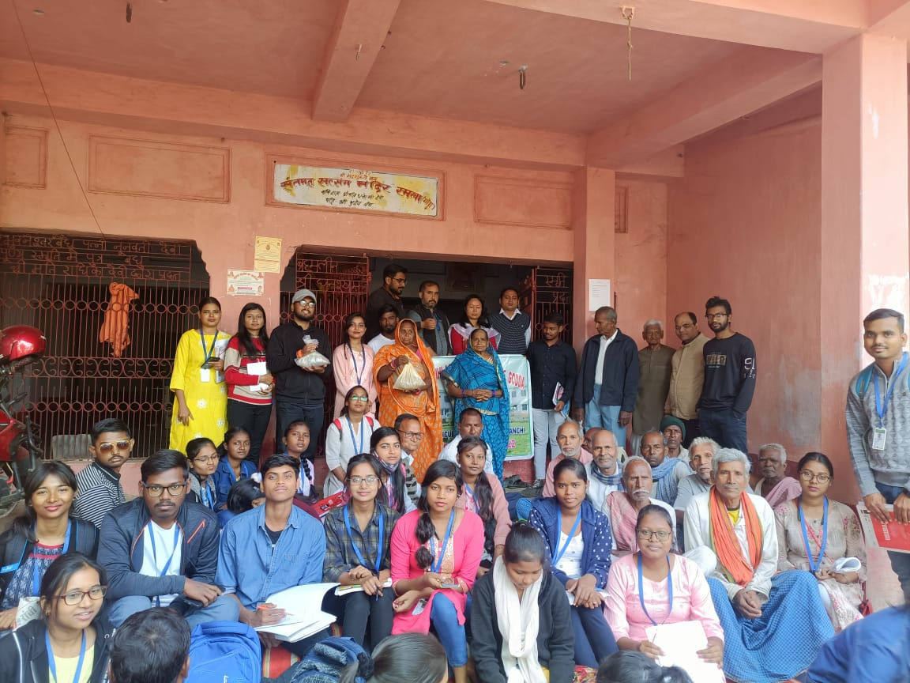
Rural Agricultural Work Experience (2022-23)
Seed Treatment
Dry seed treatment demonstration
One bag was picked and 2 g of thiram was added into the bag using gloves
Bags were handed over to the farmers. We told them to leave it for 24 hours and then sow it immediately in the fields
Bag was shaken so that it could get mixed thoroughly and a thin layer of fungicide was formed around the seeds (mouth of bags must be held tightly)
10 kg of linseed was taken in 10 different bags containing 1 kg of linseed each

Slide 30
Rural Agricultural Work Experience (2022-23)
Crop disease profile
Sl. | Crop | Disease | Symptoms | Farmers Practice | Recommendations | IDM
1. | Mustard | Alternaria blight | Small circular brown spots, Enlarge form concentric rings, cover large patches | 10 ml of SAAF in 20 litres of water. | Early sowing and deep ploughing. Weeding and maintenance of opt. plant population. | Deep summer ploughing Hot water treatment at 50˚c for 20 min Seed treatment with Captan /Thiram @2g/kg seed
2. | Wheat | Loose smut | In affected spikelets, ears transformed into black powdery masses consisting of smut pores, packed under a thin membrane. | Nothing | Hot water treatment-soaking the seed in cold water for 4 hrs followed by dipping in hot water at 54-56˚c for 10 min | Resistant variety Kalyan sona, PV18 Hot water treatment at 50˚c for 20 min. Solar heat treatment - seeds are soaked in water for 4 hours & then spread in thin layer under blazing sun, when temp. rises 50˚c . Seed treatment with vitavax @2-2.5 g/kg seed
3. | Potato | Common scab | Small brownish, slightly raised spots on tuber coalesce & become corky | Nothing | Crop rotation with non host plant (for 4 years) Use acidic fertilizer like Calcium ammonium nitrate | Crop rotation with non host plant (wheat, legumes) Crop manuring with green gram or sun hemp in kharif. Hold PH at about 5.3 by adding Sulphur

Slide 31
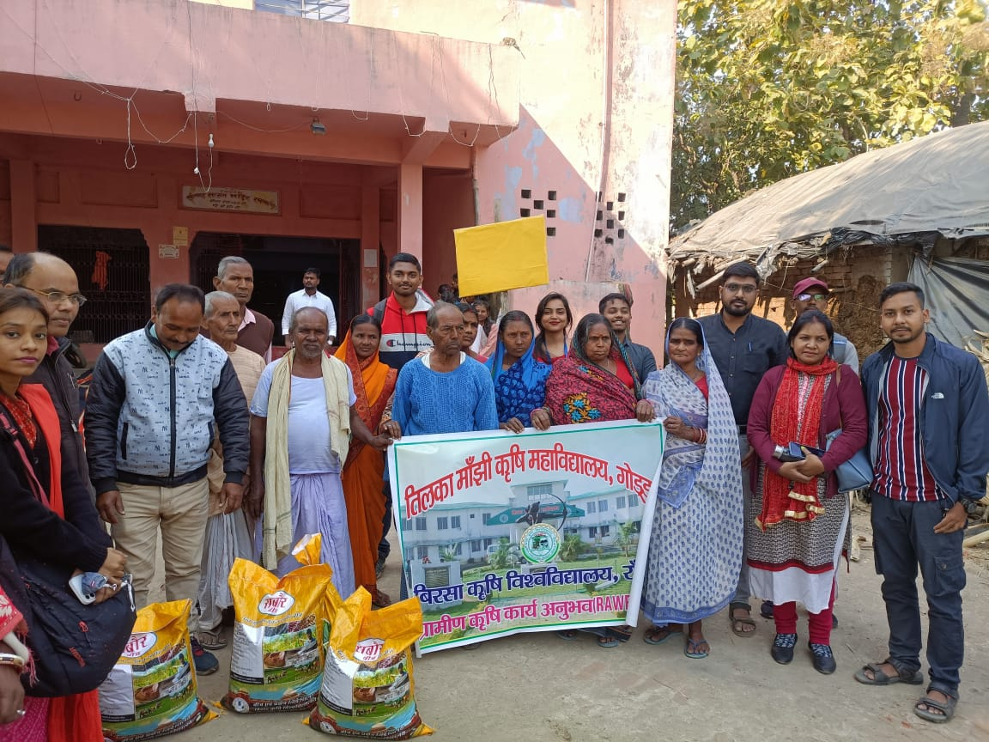
Agricultural
Extension
INTERVENTION

Slide 32
Rural Agricultural Work Experience (2022-23)
Common details of farmer
SI. No. | Name | Age | Area (ha) | Gender | Educational qualification | Caste
 | Sintu Kumar | 27 | 0.107 | male | matriculation | OBC
 | Bhawani Devi | 40 | 0.144 | Female | Can read and write only | OBC
 | Hardev Mandal | 55 | 0.92 | Male | 8th pass | OBC
 | Shrikant Mandal | 58 | 0.28 | Male | 8th Pass | OBC
 | Dhananjay Vaidh | 56 | 0.46 | Male | Can read and write only | OBC
 | Basant Mandal | 60 | 0.20 | Male | Can read and write only | OBC
 | Shri Sitaram Vaidh | 47 | 0.46 | Male | Graduate | OBC
 | Chandan Kumar Vaid | 28 | 0.46 | Male | Intermediate | OBC
 | Chakardhar Manjhi | 60 | 0.23 | Male | 5th Pass | OBC

Slide 33
Rural Agricultural Work Experience (2022-23)
Age classification
Educational Qualification
Gender

Slide 34
Rural Agricultural Work Experience (2022-23)
High School Survey
Class IX – 144 students (73 Male & 71 Female)
Class X – 123 students (62 M & 61 F)
Science
Class XI – 33 students (20 M & 13 F)
Class XII – 9 students (3 M & 6 F)
Arts
Class XI – 61 students (21 M & 40 F)
Class XII – 58 students (27 M & 31 F)
IT Vocational
Class IX – 68 students
Class X – 49 students
Class XI – 46 students
Class XII – 33 students
Electronic
Class IX – 63 students
Class X – 47 students
Class XI – 52 students
Class XII – 32 students

Slide 35
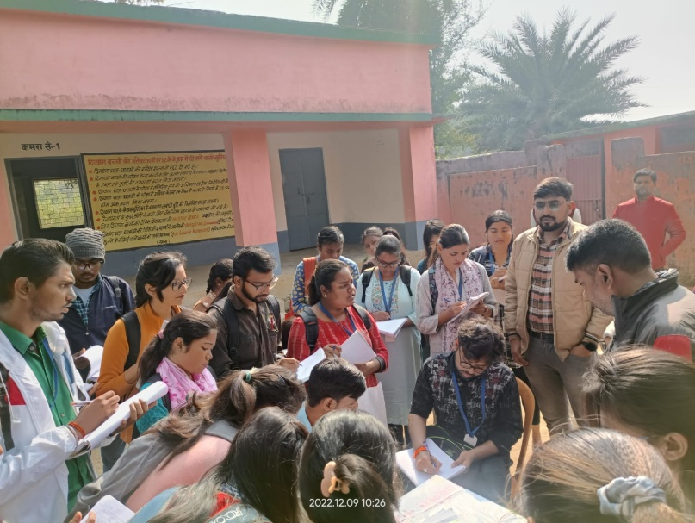
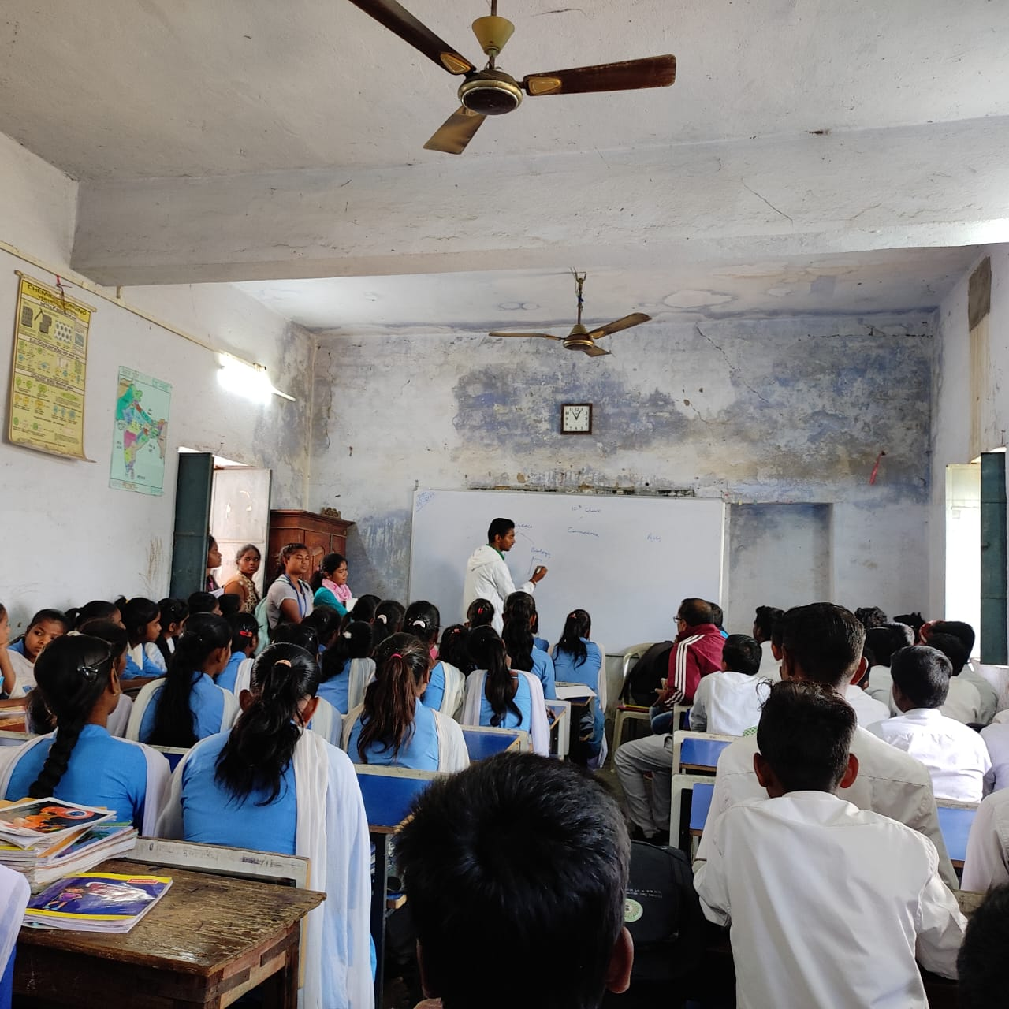
Rural Agricultural Work Experience (2022-23)
Primary and Middle School Survey
Total students : 275
Total girls : 147
Total boys : 132
Total class : 1 to 8
Total teachers : 3 (1 female, 2 male)
Head teacher : Dilip Kr. Sah
Teacher : Sobha Kumari, Aditya Kumar Anand (1 to 5), Dilip kr. Sah (Headmaster)
School established : 1955
Washroom : 2-6
Attendance good (75% - 80%)
Gyan setu karyakarm (Program)
Area 5 kattha (8000 sq. feet)

Slide 36
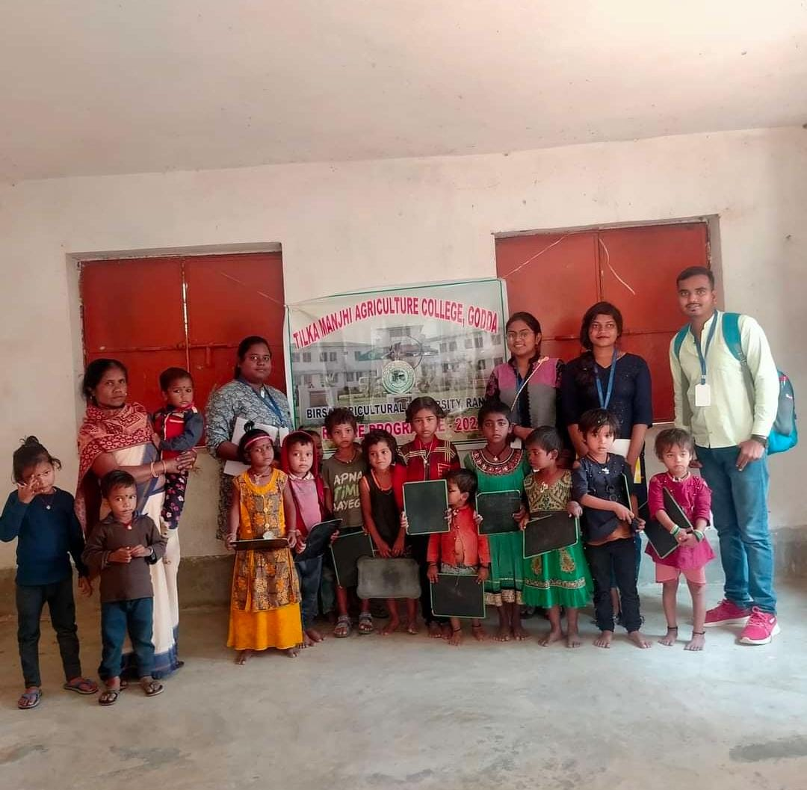
Rural Agricultural Work Experience (2022-23)
Aaganbaadi Survey
Established : 22 Sept. 2009
Head : Giriwala Kumari
Staff : 2
Food Source : Own ( Money from Government)
Area : 1 hectare
Study Material : Pencil, Slate ( given by Government)
Office : Godda Block
Students
Age | No. of Students
0-3 yrs | 69
3-6 yrs | 40
Total | 109

Slide 37
Rural Agricultural Work Experience (2022-23)
PRA – Participatory Rural Appraisal
PRA is a methodology for interacting with villagers and seeking their participation in putting forward their point of views about problem analyzing and equalizing the information to acquire learning
Aims of PRA
To build up a permanent “people first” attitudes in the minds of the participants
To establish a notion of “respect” to the people’s knowledge in the life of professionals and their institutions.
To provide simple analytical tools to analyze rural situations.
To show some of the analytical tools to the community in the field setting and understand their suitability to farmer situation
To enhance participant’s ability to plan with the community.

Slide 38
Rural Agricultural Work Experience (2022-23)
PRA – Participatory Rural Appraisal
Optimal ignorance
Offsetting biases
Listening and learning
Triangulation
Principles governing the basis of any PRA activity
Multi-disciplinary team
Self-Critical Awareness
Team-work
Seeking Diversity
Participation

Slide 39
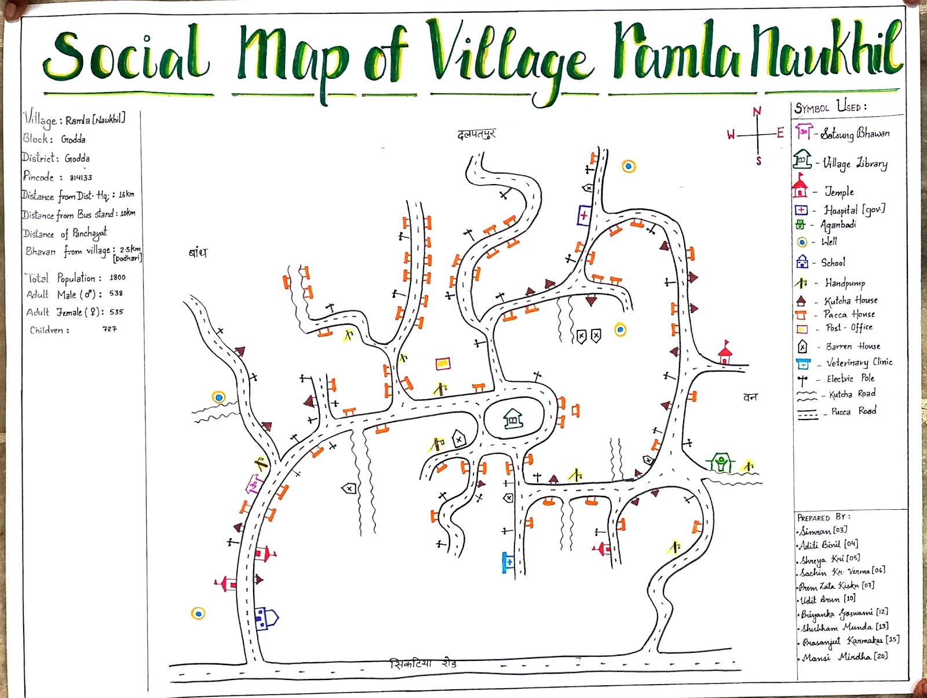
Rural Agricultural Work Experience (2022-23)
Social Map
Social map is the visual method of showing relative location of households and distribution of different people, such as male, female, adult, together with social structure groups and organization of the area.

Slide 40
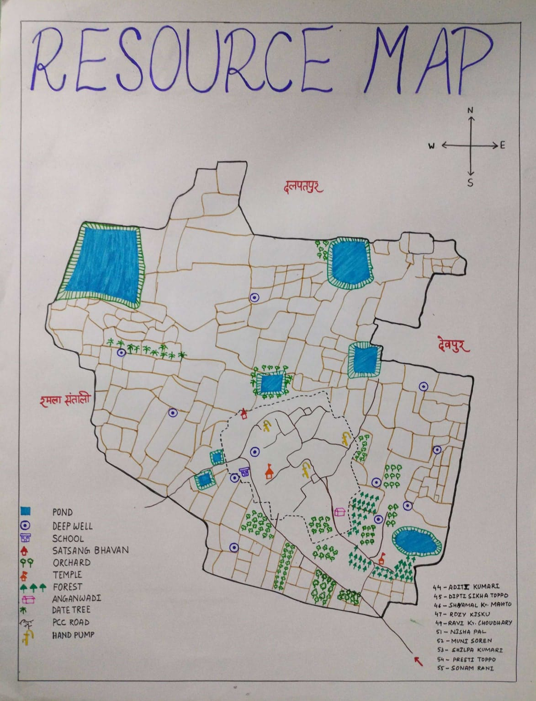
Rural Agricultural Work Experience (2022-23)
Resource Map
This map represents the major components like Land type (topography), soil types, enterprises, water resources, cropping sequence, pastureland, problematic area (if any) and other related items

Slide 41
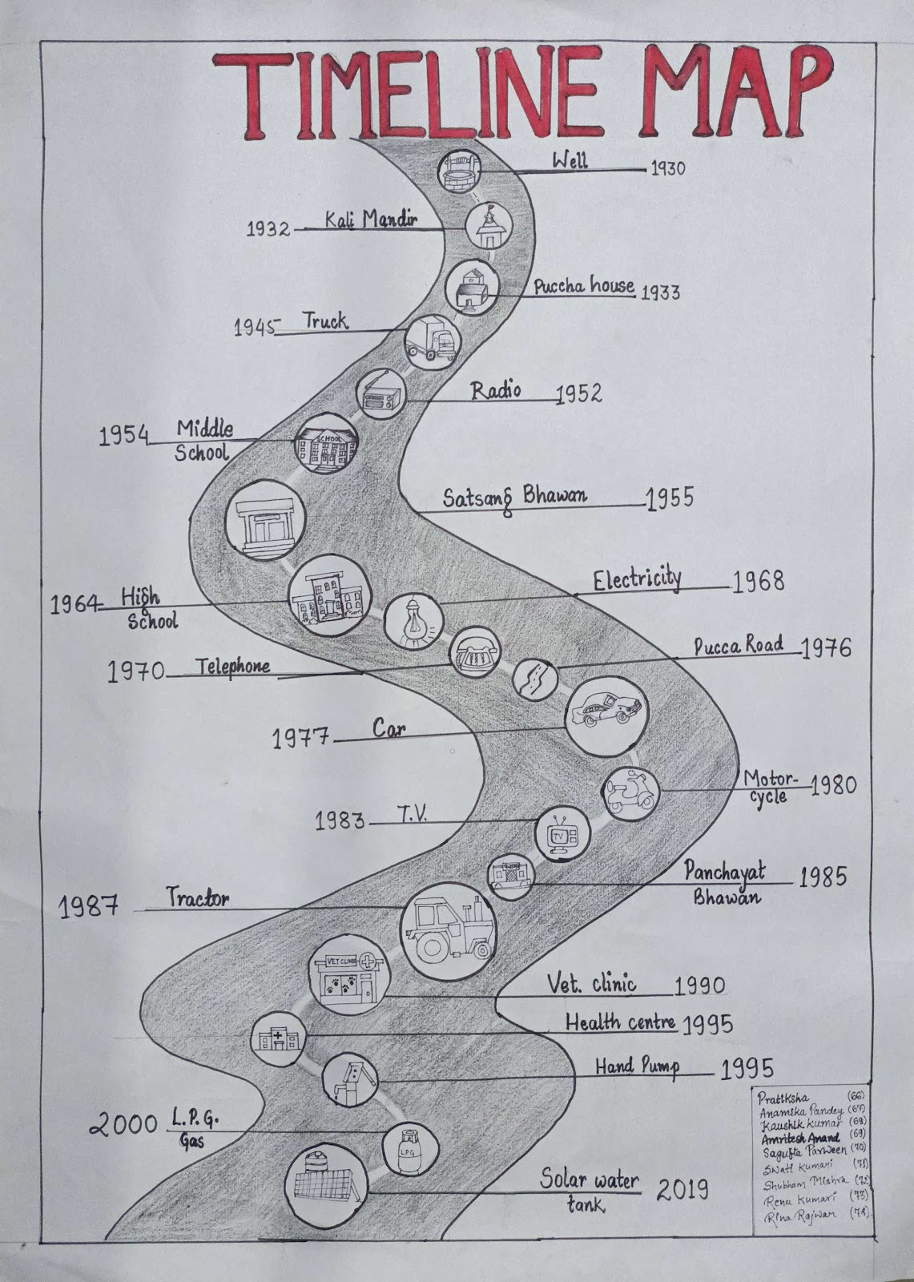
Rural Agricultural Work Experience (2022-23)
Timeline Map
The timeline with basic events can be used to focus discussions on problems, social and technological innovations or on communities' history of co-operations and activities which helped them to solve past problems successfully

Slide 42
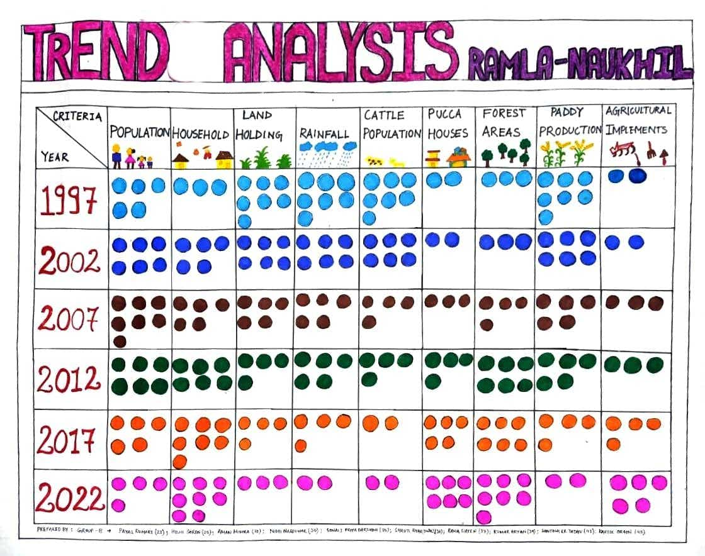
Rural Agricultural Work Experience (2022-23)
Trend Analysis Map
Time trend designs are a form of longitudinal ecological study and can provide a dynamic view of populations health status. Like other ecological studies the data are collected at a population level and can be used to generate hypothesis for further research, rather than demonstrating causality

Slide 43
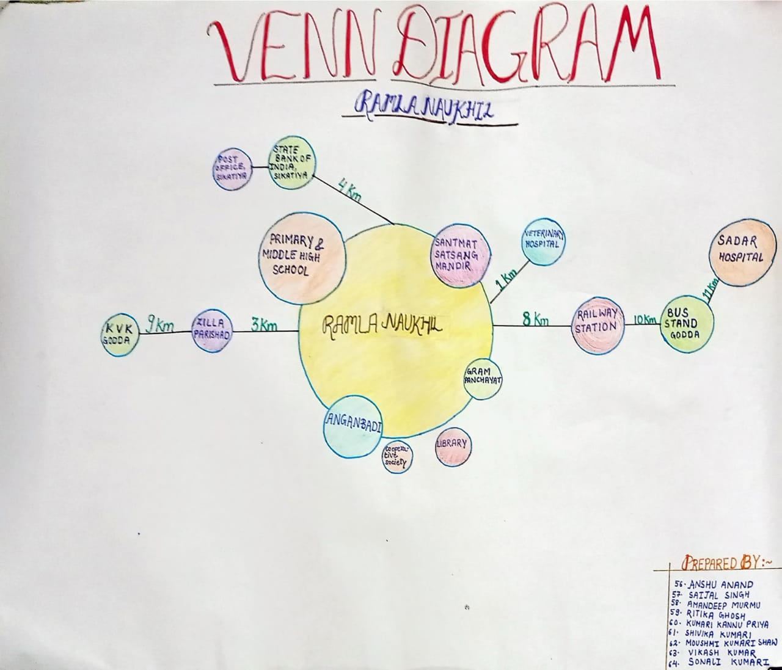
Rural Agricultural Work Experience (2022-23)
Venn diagram
The Venn Diagram on Institutions shows institutions, organizations, groups and important individuals found in the village, as well as the villagers view of their importance in the community

Slide 44
Rural Agricultural Work Experience (2022-23)
Action plan development of the village
For the unemployed youth :-
Government has launched many skill development programs, like Skill India mission, to provide training to inculcate vocational skills in the unemployed youth. E.g., carpentry, electroplating, etc.
Training from KVKs – piggery, goatery, fisheries, poultry, etc.
For farm women :-
Mushroom cultivation, Kitchen gardening, forming of self-help groups (SHGs)
In livestock sector :-
Proper vaccination of the cattle to save them from dying due to local disease and increase milk production
Growing of fodder crops, e.g., berseem, in wasteland
To mitigate water scarcity :-
Rainwater harvesting in their house by building small structures and then using the stored water for irrigation
Growing crop varieties that grow well in minimum water
Instructions for less cost of cultivation and high output :-
Seed treatment before sowing to increase the yield
Using the proper amount of fertilizer to minimize soil pollution and water pollution
Integrated disease and pest management

Slide 45
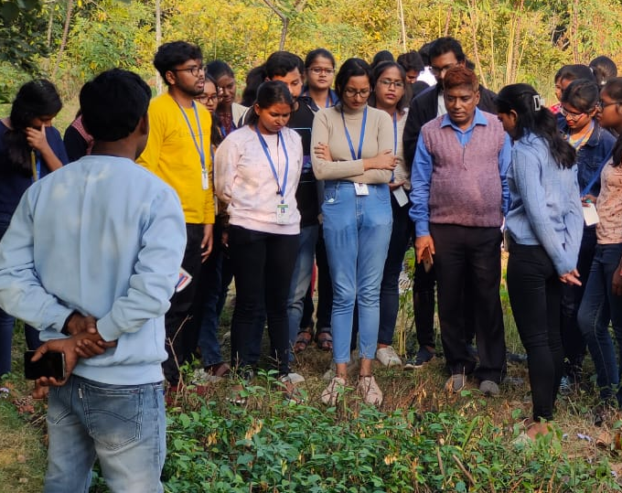
Krishi
Vigyan
Kendra

Slide 46
Rural Agricultural Work Experience (2022-23)
Krishi Vigyan Kendra
Introduction
It is devoted to undertaking the activities of technology assessment, refinement and dissemination through on-farm testing, frontline demonstration, vocational training of farmers, rural youth, farm women and extension functionaries
Mandates
On farm trial – Conduct “On-farm testing” for identifying technologies in terms of location-specific sustainable land use systems through technology assessment and refinement
Frontline demonstration – Organize frontline demonstrations on various crops to generate production data and feedback information
Capacity development (On-campus/Off-campus training) – Organize short and long-term vocational training courses in agriculture and allied vocations for the farmer and rural youth with emphasis on “learning by doing” for higher production on farms and generation of self employment
Extension functionaries – Organize training to update the extension personnel with emerging
On farm trial – Conduct “On-farm testing” for identifying technologies in terms of location-specific sustainable land use systems through technology assessment and refinement
Frontline demonstration – Organize frontline demonstrations on various crops to generate production data and feedback information
Capacity development (On-campus/Off-campus training) – Organize short and long-term vocational training courses in agriculture and allied vocations for the farmer and rural youth with emphasis on “learning by doing” for higher production on farms and generation of self employment
Advisory services -provide farm advisories using information communication technology.
Multisector support -to work as a knowledge and resource centre of agricultural technologies.

Slide 47
Rural Agricultural Work Experience (2022-23)
Krishi Vigyan Kendra
Latest technology demonstration
Learning by doing
Objectives
Farmer-Scientist interface program
Income generation activities
Organize ‘Kisaan Mela’
KVK Godda
Name of the KVK – GVT - KVK Godda
Established – year 2006
Managed by – Gramin Vikas Trust(GVT)
Funded by – Indian Council of Agriculture Research, New Delhi
Head of the KVK – Dr. Ravishankar
Owned by – NGO

Slide 48
Rural Agricultural Work Experience (2022-23)
Important activities of KVK in past 1 year
Piggery training
Plant protection and propagation training
Fishery training
Soil testing
On Campus
Horticultural seedling, sapling development
INM
Preservation and value addition of fruits and vegetables
Entrepreneur-ship development
Natural resource management
Frontline demonstration
Off Campus
One day training on season
Seed production
FPO and SHG formation

Slide 49
Rural Agricultural Work Experience (2022-23)
Activities of KVK
Research
Agriculture - Breeder seed demonstration, Seed production (breeder to certified)
Including horticulture - Development of seedlings and saplings, nursery development of various vegetable crops (brinjal, tomato, cauliflower, cabbage)
Seed production of vegetable crops ( brinjal, tomato, onion)
Sapling development of guava, mango, drumstick
Veterinary including poultry- Demonstration of feed conversion ratio of Jharsuk
Demonstration
Agriculture - 7 demonstration and 40 awareness programme on Natural Farming
Including horticulture - Demonstration of nutritional garden
Veterinary including poultry, fisheries - Demonstration of feed conversion ratio of Jharsuk
Fisheries - Composite Fish Farming
Home science - Preservation and value addition of horticultural crops

Slide 50
Rural Agricultural Work Experience (2022-23)
Activities of KVK
Trainings
Agriculture Including horticulture , Training on soil sample collection
Veterinary including - piggery
Achievements of KVK
NICRA ( National Innovation on Climate Resilient Agriculture ) Project in 4 village
Natural farming – use of Bijamrit, Jivamrit

Slide 51
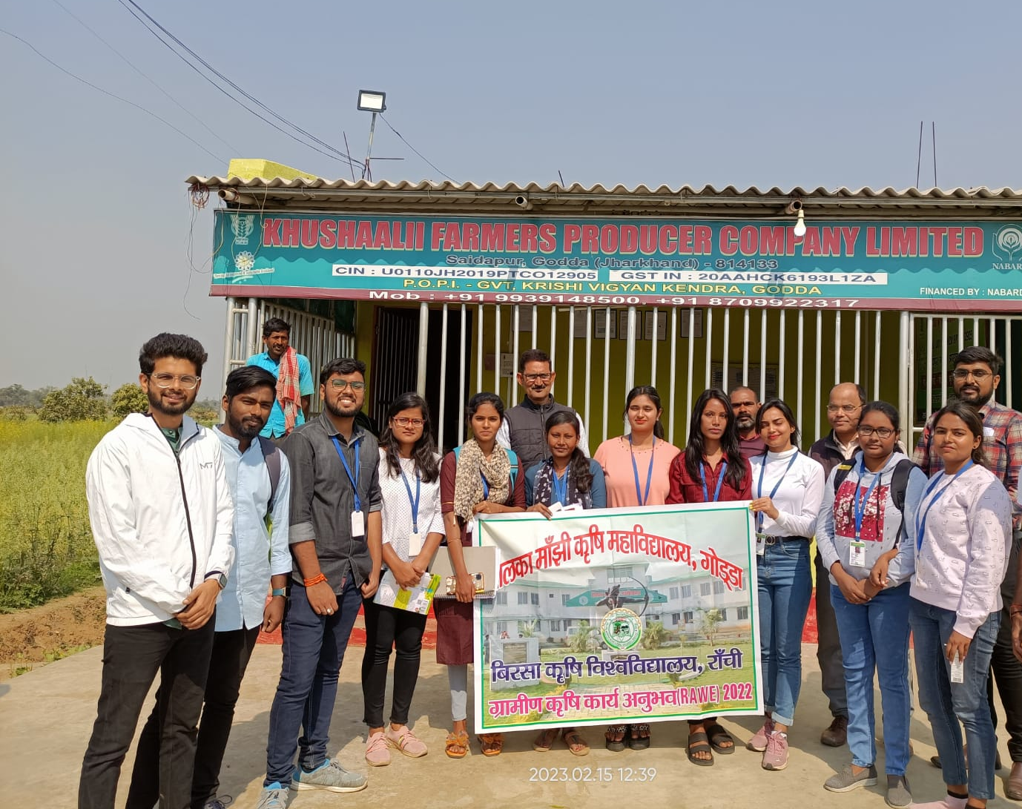
Agro –
Industrial
Attachment

Slide 52
Rural Agricultural Work Experience (2022-23)
FPO
Farmers Producer Organizations (FPOs) are collectives of small and marginal farmers that are formed with the objective of enhancing their income through collective action
They are owned and managed by farmers themselves
FPO Godda
Company Name | KHUSHAALI FARMERS PRODUCER COMPANY LIMITED
Company Status | Active
Registration Number | 12905
Company Category | Company limited by Shares
Company Sub Category | Non-govt company
Class of Company | Private
Date of Incorporation | 02 May 2019
Age of Company | 3 years, 10 month
Activity | Growing of crops; market gardening; horticulture; Milk collection; Seed production.

Slide 53
Rural Agricultural Work Experience (2022-23)
FPO
Management members and staff
CEO details
This FPO started with
10 Farmers
5 Board of directors
1 CEO
Currently 505 members have been registered and 300 members are in process.
Name – Mr. Priyabraj Jha
Education – B.A. (History Hons.)
About the Project
The main purpose of the project is to collect milk from the farmers and act as link between farmers and mother's dairy
300 active members connected with the milk collection centre at FPO.
FPO currently serves 10 villages of the 3 blocks, Godda , Meharama, and Mahagama in the Godda district
Product – On an average cow milk contains 87 per cent water, 3.9 per cent fat, 4.9 per cent lactose, 3.5 per cent protein and 0.7 per cent minerals and vitamins and other minor constituents

Slide 54
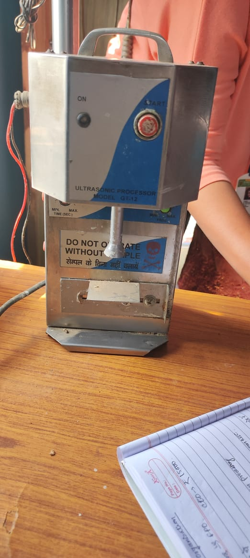
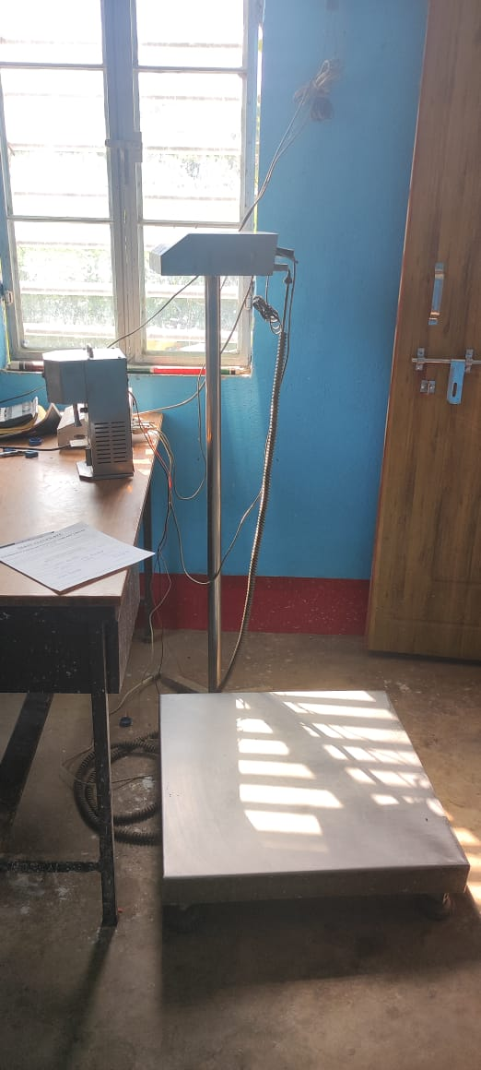
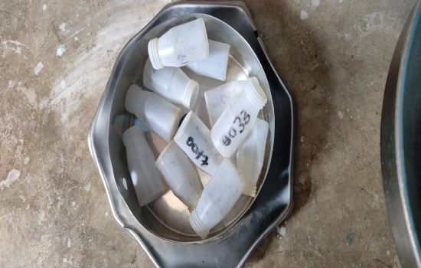
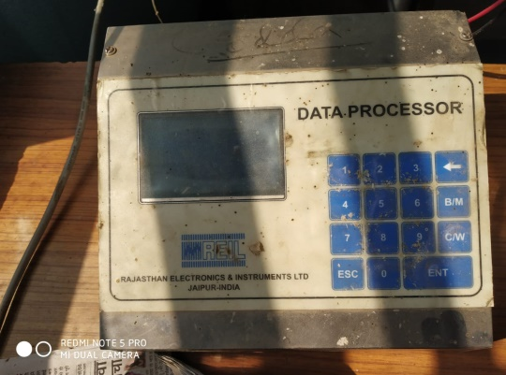
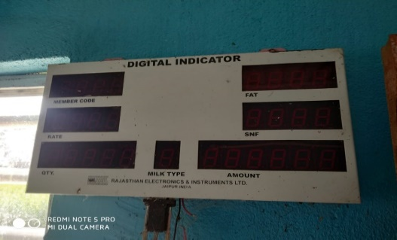
Rural Agricultural Work Experience (2022-23)
Process flow chart
Lacto Scanner - Milk filled plastic bottles are then put into the Lacto scanner to obtain the information of fat and SNF
Weighing machine - The milk collected from the farmers is weighed in the weighing machine
Plastic bottle - The collected milk sample is filled in the small plastic bottles
Digital Indicator - The data of fat, SNF and rate of milk is indicated in the data indicator
Data Processor - Data processor process the complete data of the milk

Slide 55
Balance sheet
Rural Agricultural Work Experience (2022-23)
ASSETS | AMOUNT | LIABILITIES | AMOUNT
CURRENT ASSETS |  | CURRENT LIABILTIES
CASH ON HAND | Rs. 25,000 | LOAN TO BE PAID | Rs. 1,40,000
SAVING IN BANK | Rs. 1,00,000 | COST OF PRODUCT | Rs. 58,40,000
LIVESTOCK PRODUCT(MILK) | Rs. 73,00,000 | COST OF MAINTENCE | Rs. 20000
VALUE OF BONDS AND SHARES | Rs. 2000 | OPERATING COST | Rs. 6,47,300
SUB TOTAL | Rs. 74,27,000 | SUB TOTAL | Rs. 65,16,300
INTERMIDIATE ASSETS |  | INTERMEDIATE LIABILITIES
MACHINERY AND EQUIPMENT | Rs. 2,50,000 | MACHINERY LOAN | Rs. 60,000
DAIRY CATTLE | Rs. 60,000
SUB TOTAL | Rs. 3,10,000 | SUB TOTAL | Rs. 60,000
LONG TERM ASSETS |  | LONG TERM LIABILTIES
LAND VALUE | Rs. 10,00,000 | WORKING CAPITAL LOAN | Rs. 5,00,000
FARM BUILDING | Rs. 5,00,000
SUB TOTAL | Rs. 15,00,000 | SUB TOTAL | Rs. 5,00,000
TOTAL ASSETS | Rs. 92,37,000 | TOTAL LIABILTIES | Rs. 70,76,300

Slide 56
Rural Agricultural Work Experience (2022-23)
Profit Statement of Khusaalii FPO
TOTAL COST MILK = Rs. 58,40,000
COST OF OPERATION = Rs. 6,40,300
COST OF MAINTENCE = Rs. 20,000
TOTAL COST = Rs.64,90,300
TOTAL SELL OF MILK = Rs.73,00,000
PROFIT= TOTAL PRICE OF MILK – TOTAL COST
PROFIT = Rs.7,99,700
PROFIT % =PROFIT*100/64,90,300
PROFIT % = 12.47

Slide 57
Rural Agricultural Work Experience (2022-23)
Income statement
PARTICULARS | AMOUNT
RECIEPTS
RETURN FROM THE SALE OF MILK | Rs. 73,00,000
APPRECTION ON THE ASSETS | Rs. 50,000
GROSS INCOME | Rs. 73,50,000
EXPENSES (OPERATING EXPENSES OR COSTS)
COST OF PLASTIC CAN | Rs. 3,28,500
SALARY OF CEO | Rs. 1,80,000
SALARY OF SKILLED WORKER | Rs. 84,000
TRAVELLING | Rs. 20,000
ELECTRICITY | Rs. 4,800
PUBLICITY EXPENSES | Rs. 10,000
STATIONERY AND PRINTING | Rs. 15,000
COMMUNICATION | Rs. 5000
AMOUNT PAID TO FARMER | Rs. 58,40,000
TOTAL OPERATING EXPENSES | Rs. 64,87,300

Slide 58
Rural Agricultural Work Experience (2022-23)
Income statement
FIXED EXPENSES OR COST
DEPRECIATION (AT THE RATE OF 15%) | Rs. 1,12,500
LAND REVENUE | Rs. 200
RENTAL VALUE OF OWNED LAND | Rs. 15,000
TOTAL FIXED COST | Rs. 1,27,700
NET OPERATING INCOME | Rs. 8,62,700
NET FARM INCOME | Rs. 7,35,000

Slide 59
Rural Agricultural Work Experience (2022-23)
SWOC Analysis
Strength:-
Good road connectivity
Skilled labour
Increasing purchasing capacity of milk from farmers
Easy availability of subsidy from government
Frequent payment to farmers
Good marketing channel
Weakness:-
Scare capital for investment
Lack of machinery
Lack of skilled labour
Storage problem
Erratic power supply
Regional imbalance of milk
Lack of infrastructure
S
W
C
O
Opportunity:-
Integrated structure of livestock, marketing of milk and milk products
Availability of milk in low price
Installation of machinery can help to increase income
Growing demand for milk and milk products
Employment generation
Challenges:-
Milk is a perishable product
Low productivity of milk
Lack of knowledge of proper feed & care to the cattle.

Slide 60
THANK YOU

